Slide 1
Best Neighborhood
in Pittsburgh
Team NIDASA

Slide 2
AKA Best Quality Of Life

Slide 3
Community
Metric #1

Slide 4
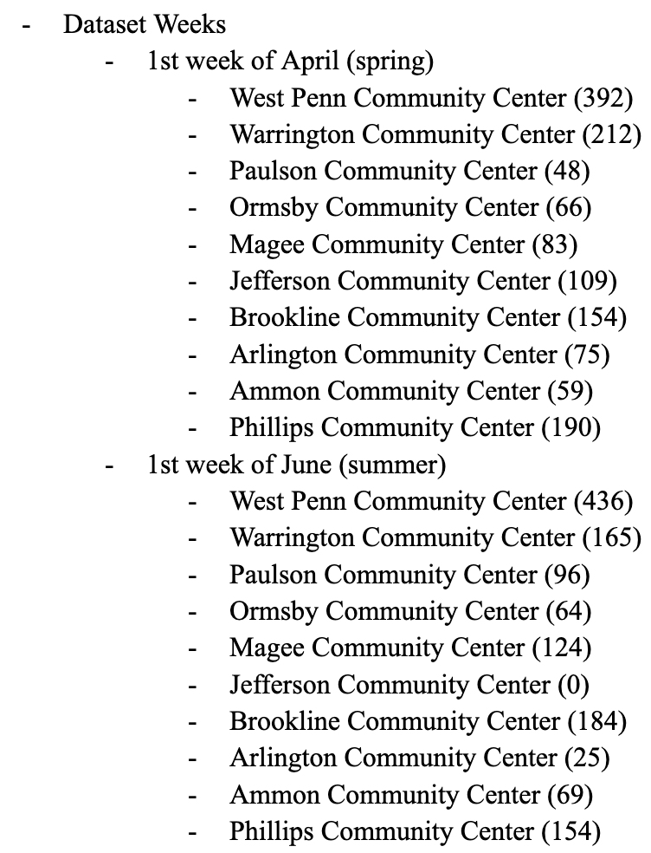
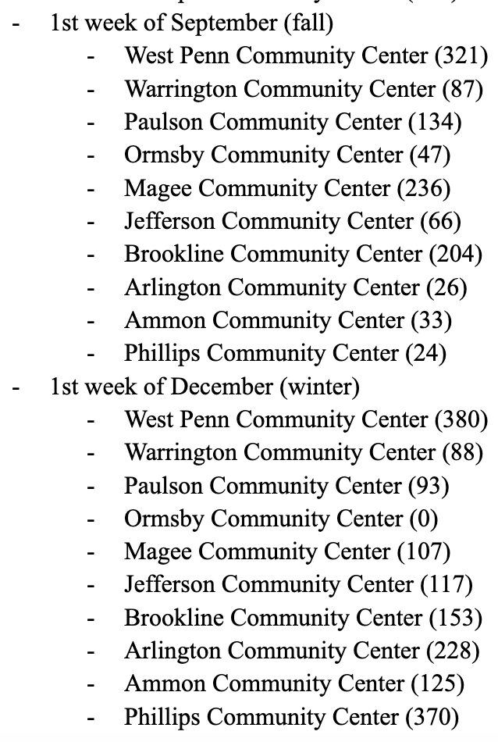
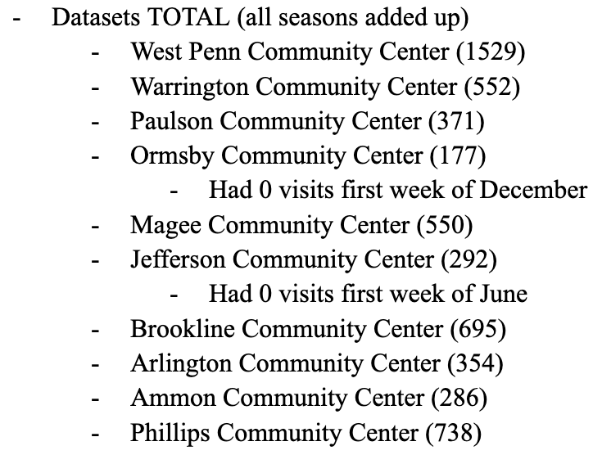
Daily Community Center Attendance
Getting The Data
Collected community center visits
Totaled the visits from the first week of each season to fairly represent the year
Totaled the visits for each community center

Slide 5
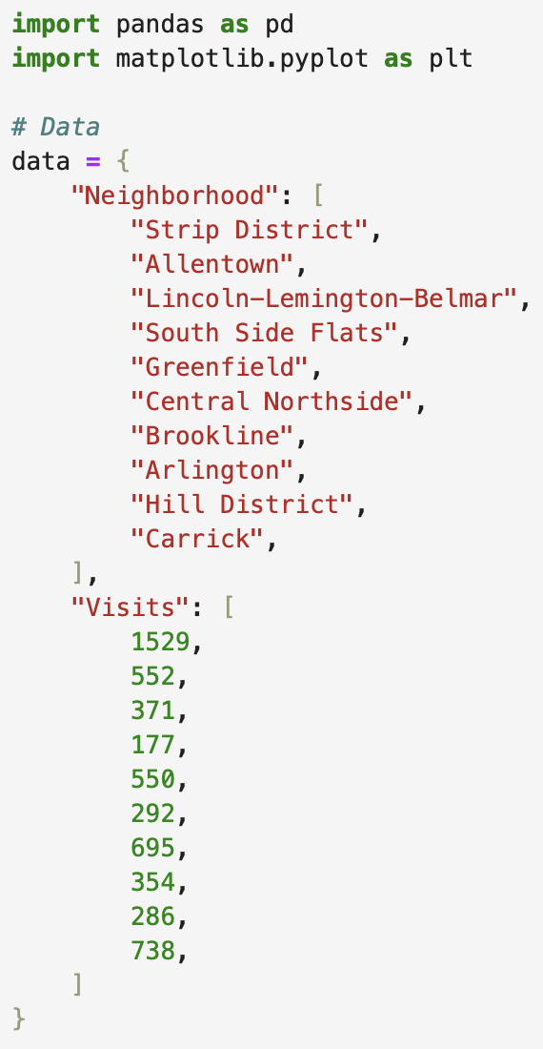
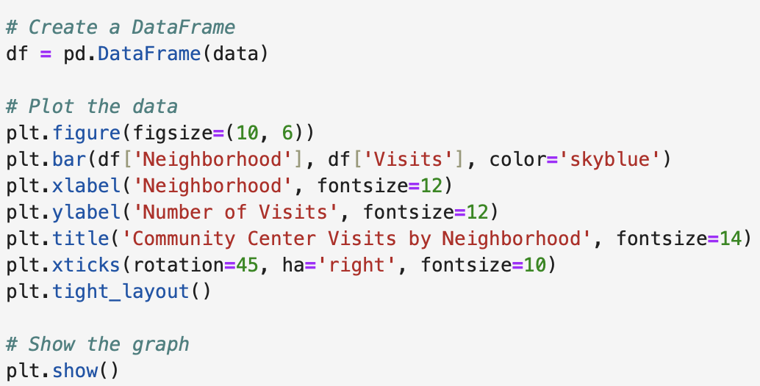
Code
Using the data I collected I added the neighborhoods that the community centers were located in and coded a bar graph to represent my data

Slide 6
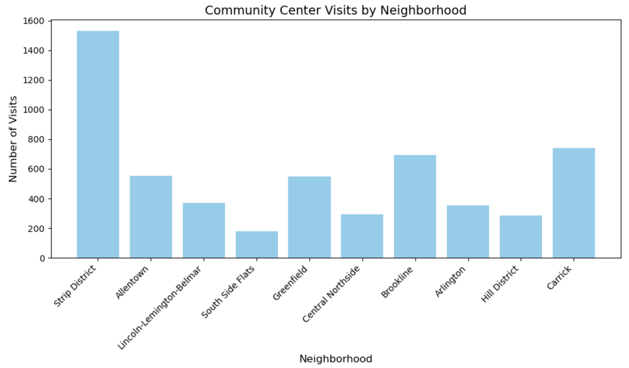

Slide 7
Point System (0-10)
0 : < 200
1: 200 - 299
2: 300 - 399
3: 400 - 499
4: 500 - 599
5: 600 - 699
6: 700 - 799
7: 800 - 899
8: 900 - 1099
9: 1100 - 1299
10: > or = 1300
Results
0:
South Side Flats
1:
Central Northside
Hill District
3:
Lincoln-Lemington-Belmar
Arlington
4:
Allentown
Greenfield
5:
Brookline
6:
Carrick
10:
Strip District
Conclusion
Based on the data from daily community center visits, the best neighborhood is the strip district.
Personal Opinion
I have lived 1.5 hours away from Pittsburgh in Johnstown my whole life. I am more familiar with the Monroeville area but I do go to the Strip District a lot. I think a “best neighborhood” is defined more by fun/entertainment. So for that and for familiarity reasons, and because Salem’s Market is there, I believe the Strip District is the best neighborhood in Pittsburgh.

Slide 8
Transportation
Metric #2

Slide 9
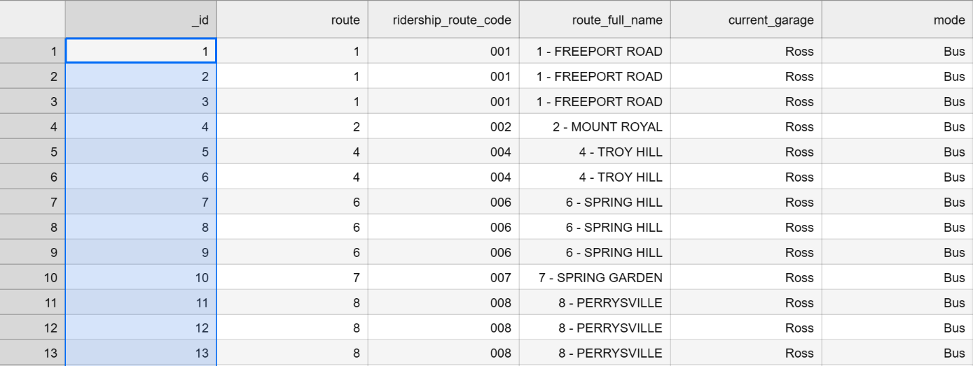
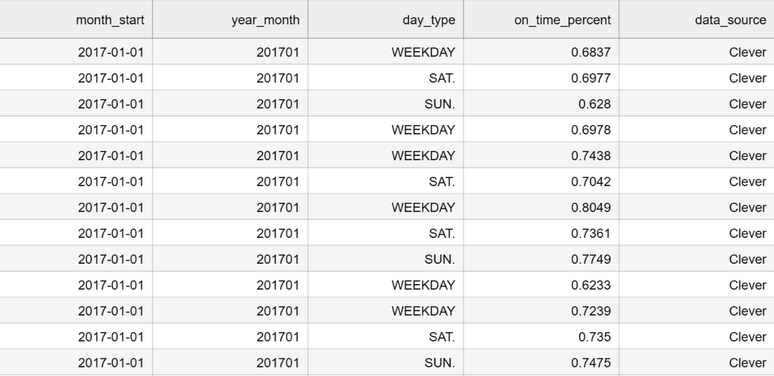
Transportation Data (Nicky)
DATASET CHOICE:
Monthly OTP by Route (from 2017/1 to 2024/8)
METRIC:
Iterate through all the data’s “current_garage” column, if the garage name is the same, add up the “on_time_percentage” and get the mean. Compared through all the means, the area that has the garage which has buses that have the highest average on-time percentage will be the best neighborhood in Pittsburgh.

Slide 10
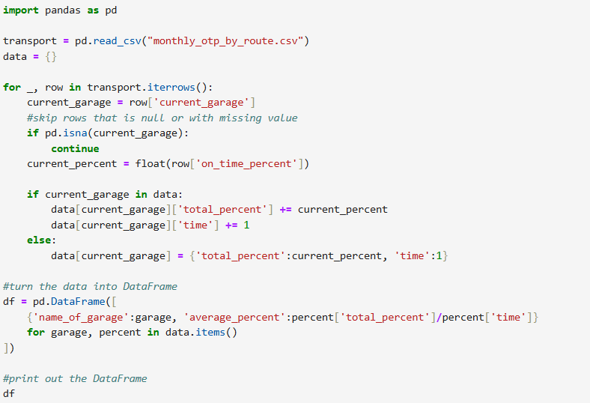
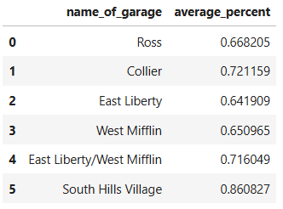

Slide 11
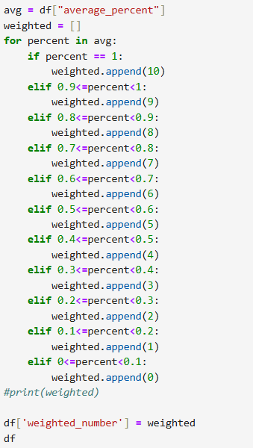
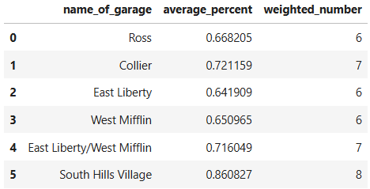
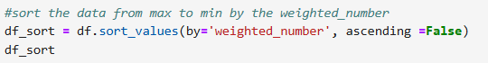
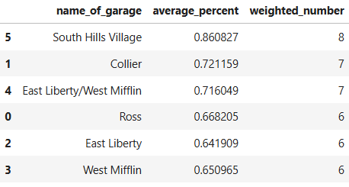

Slide 12
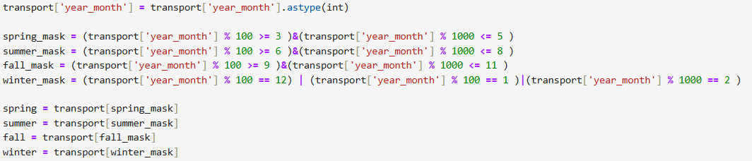
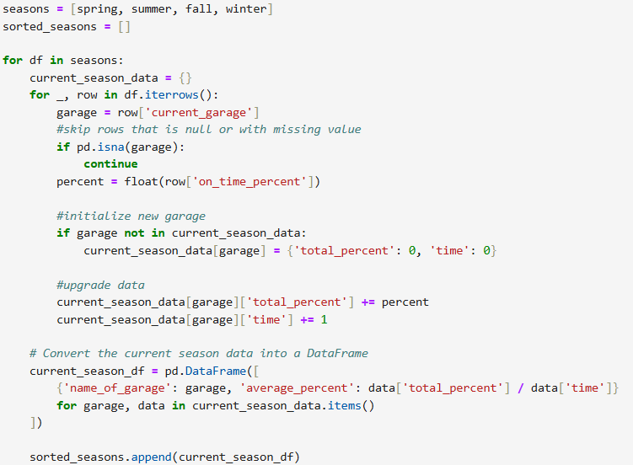
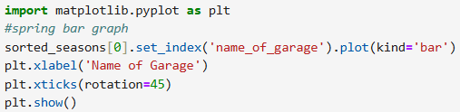
*4

Slide 13
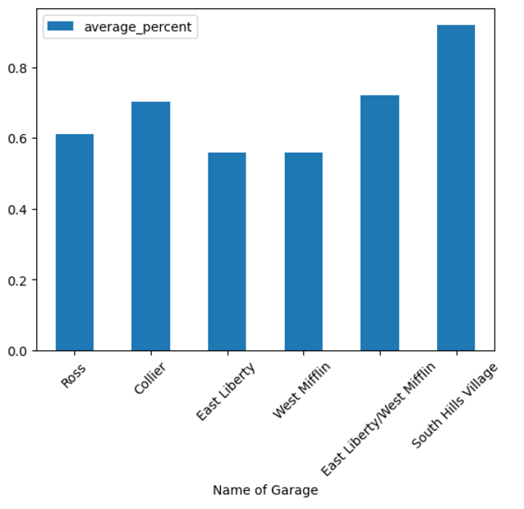
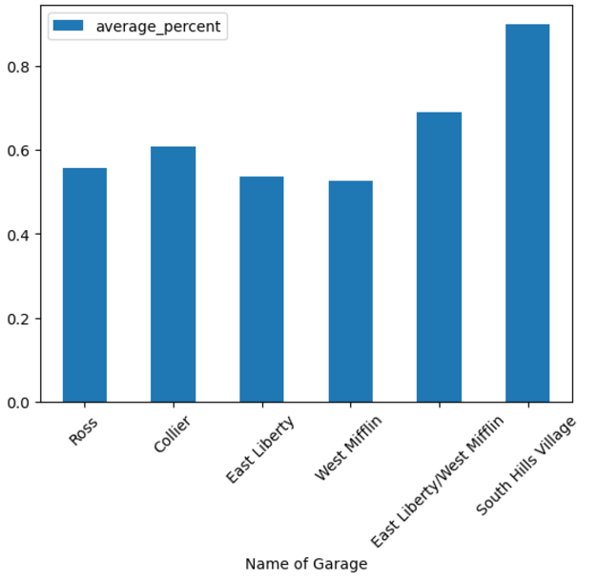
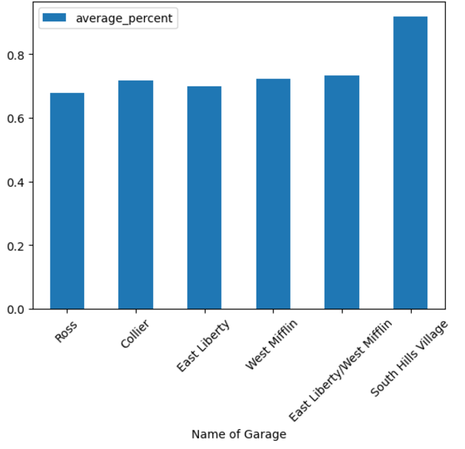
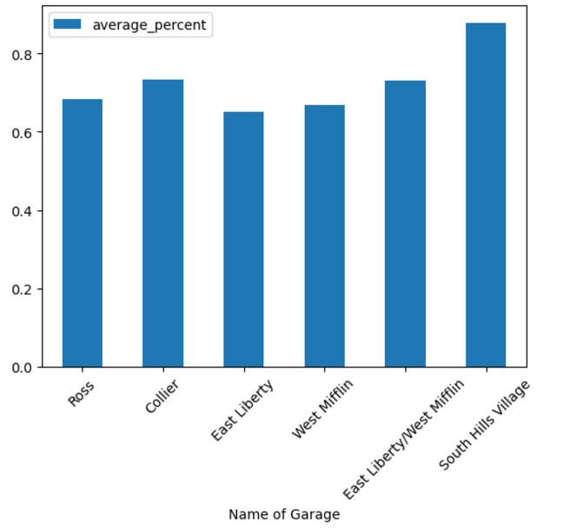
COMPARISON BETWEEN SEASONS
SPRING
SUMMER
FALL
WINTER

Slide 14
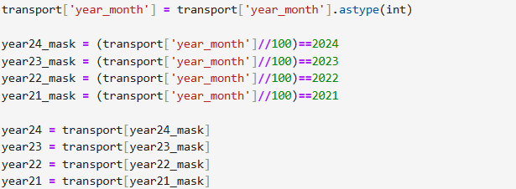
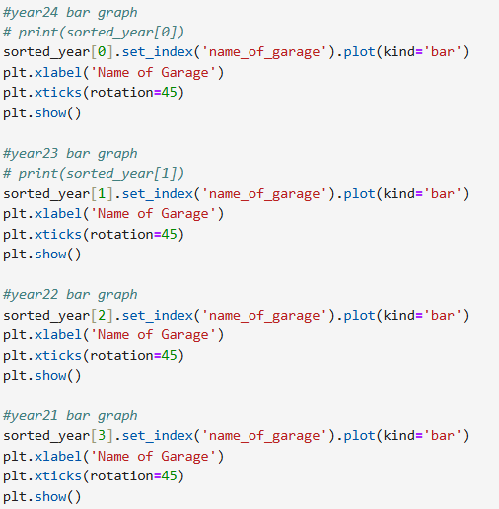
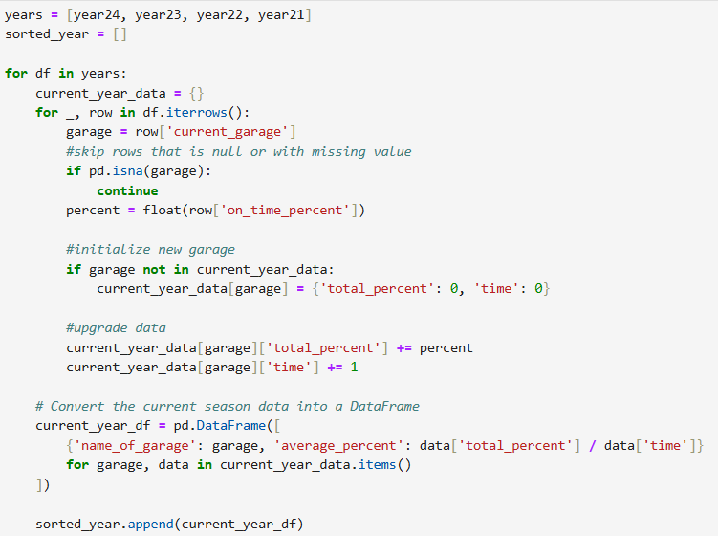

Slide 15
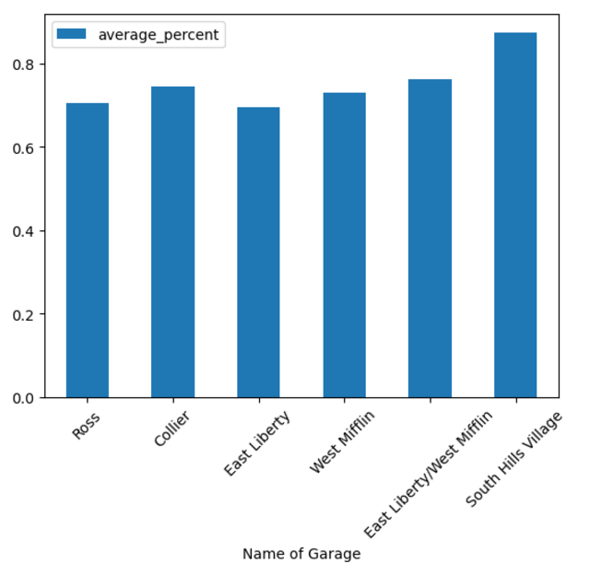
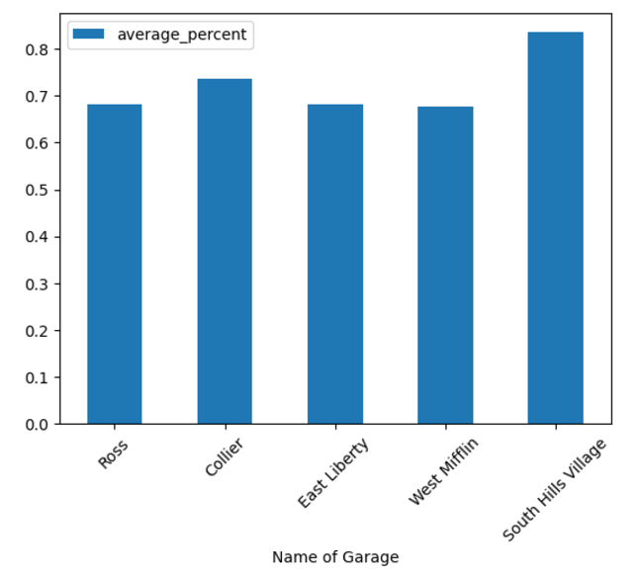
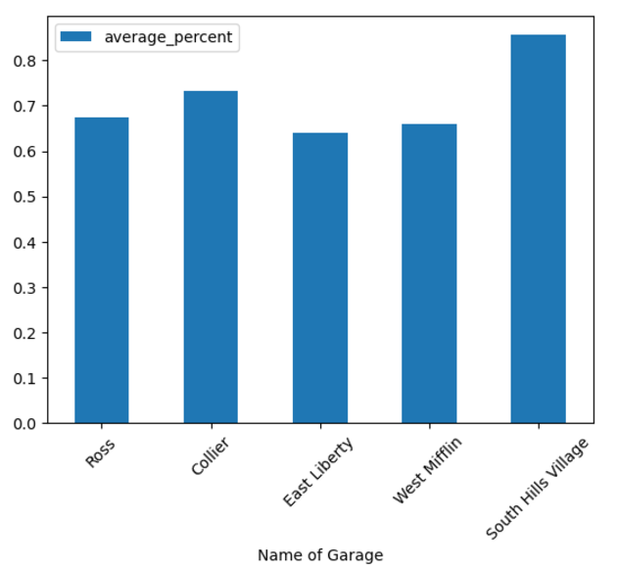
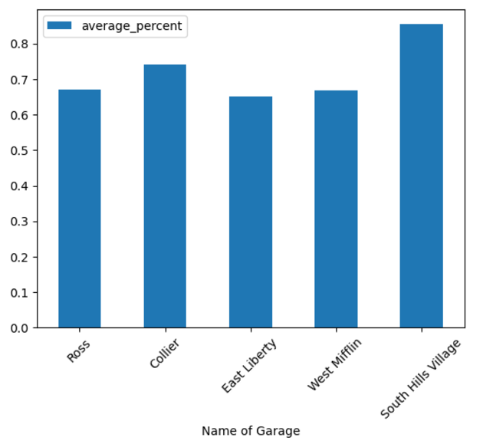
COMPARISON BETWEEN YEARS
2021
2022
2023
2024

Slide 16
SOUTH HILLS VILLAGE
located in Bethel Park
part of the South Hill region in Pittsburgh

Slide 17
Image
Metric #3

Slide 18
Image
Definition:
At Nidasasa, we define 'Image' as the overall visual and functional state of a neighborhood. This includes how clean, orderly, and well-maintained it appears. This metric provides insight into the neighborhood's quality of life and its appeal to residents and visitors.
Dataset
For the Dataset to assess the image we chose: Pittsburgh PLI/DOMI/ES Violations Report
This dataset list the violations in the city of pittsburgh and the address at which they occurred.
What are these violations?
Violations in this dataset include issues such as littering, graffiti, illegal dumping, improper waste disposal, and property maintenance infractions.
Notes:
"Analyzing these violations allows us to quantitatively measure the cleanliness and overall 'image' of each neighborhood."

Slide 19
Methodology
Data Collection
We sourced data from Pittsburgh PLI/DOMI/ES Violations Report (2023), which includes violation types, locations, and timestamps.
Metric Development
We defined 'Image' as the cleanliness of a neighborhood, measured through the number of violations recorded. 10 being the cleanest and 0 being the dirtiest
Data Analysis
Violations were grouped by neighborhood to calculate total counts. The data was sorted to identify neighborhoods with the most and least violations.

Slide 20
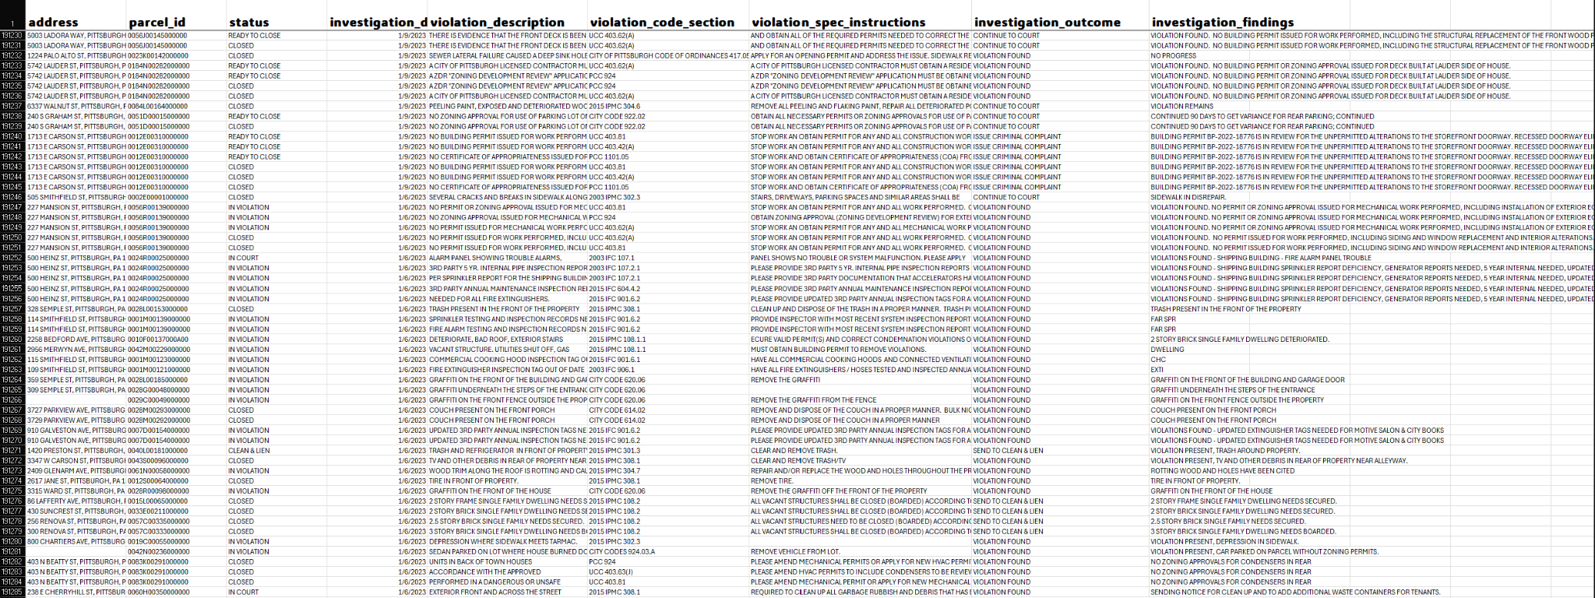
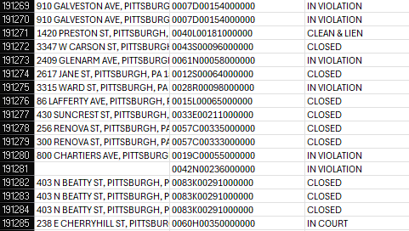

Slide 21
190,000+ entries of data
Not grouped by Neighborhood
100%
That’s a lot of violations
That’s a problem
Can do attitude

Slide 22
However where challenge lay. Innovation is born

Slide 23
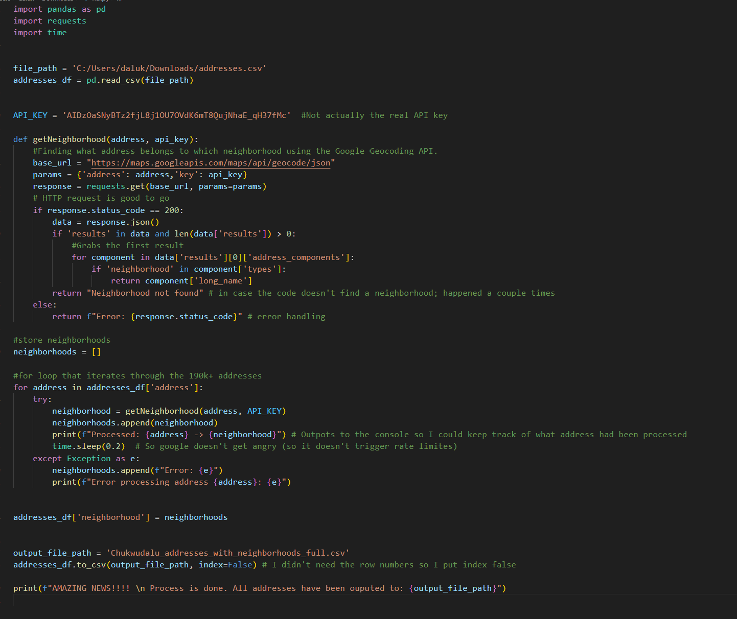
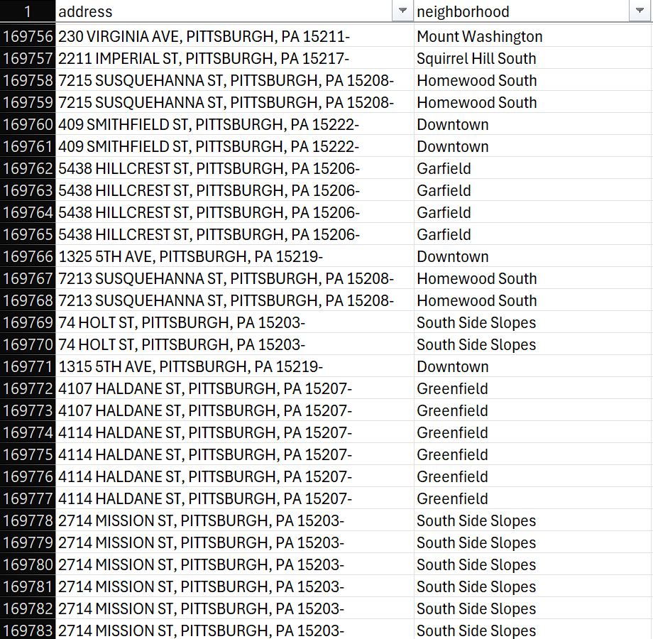
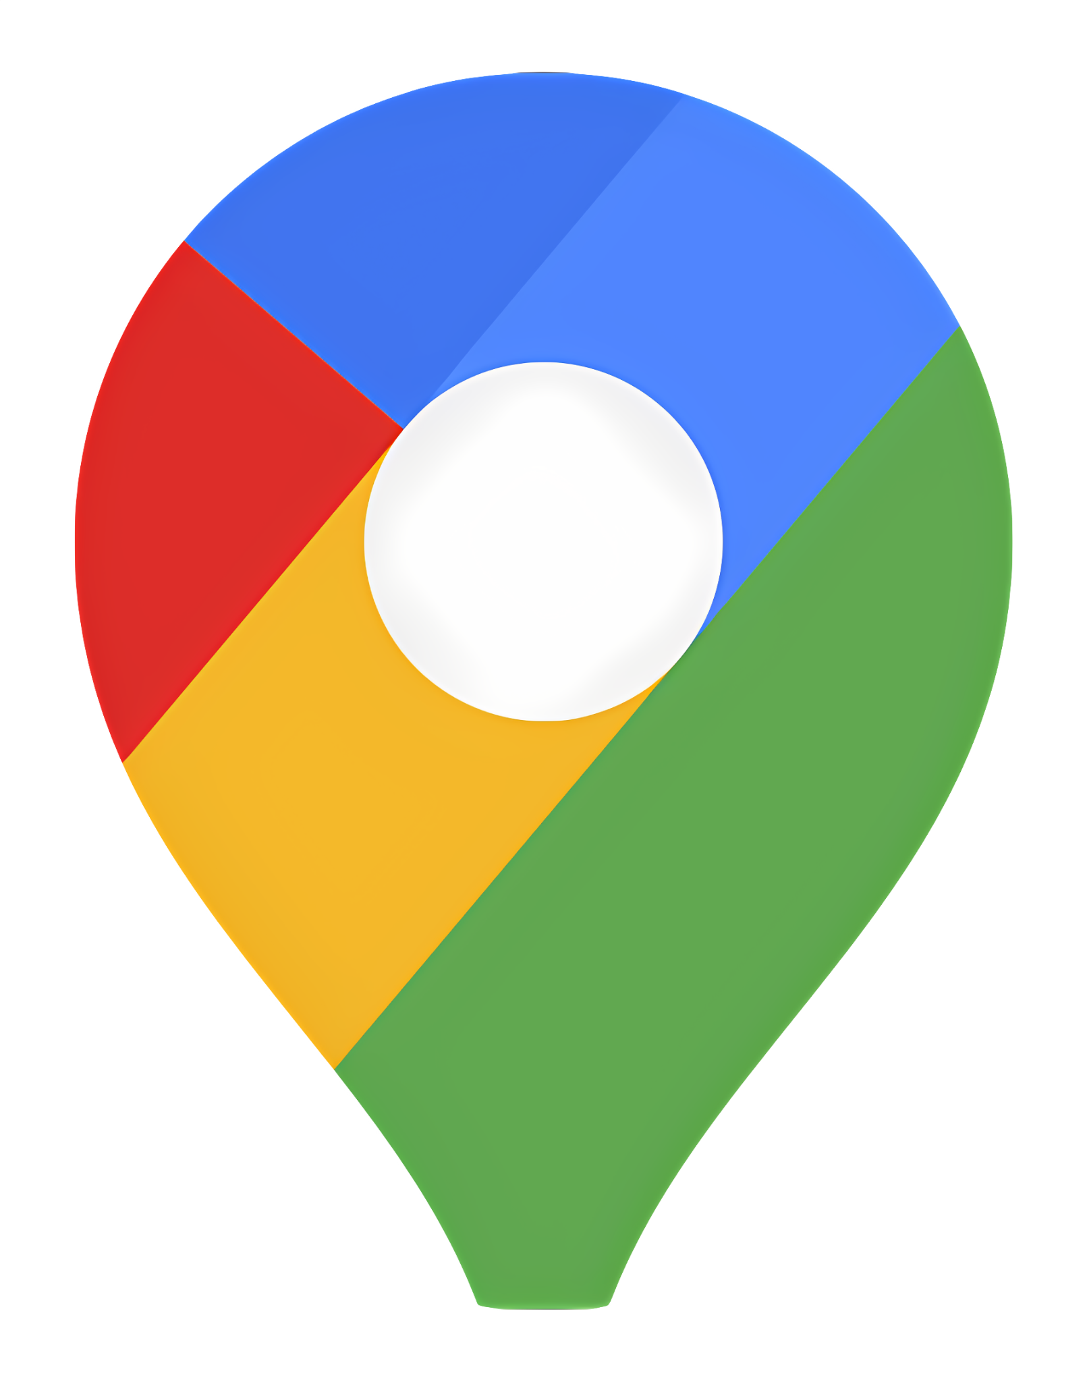

Slide 24
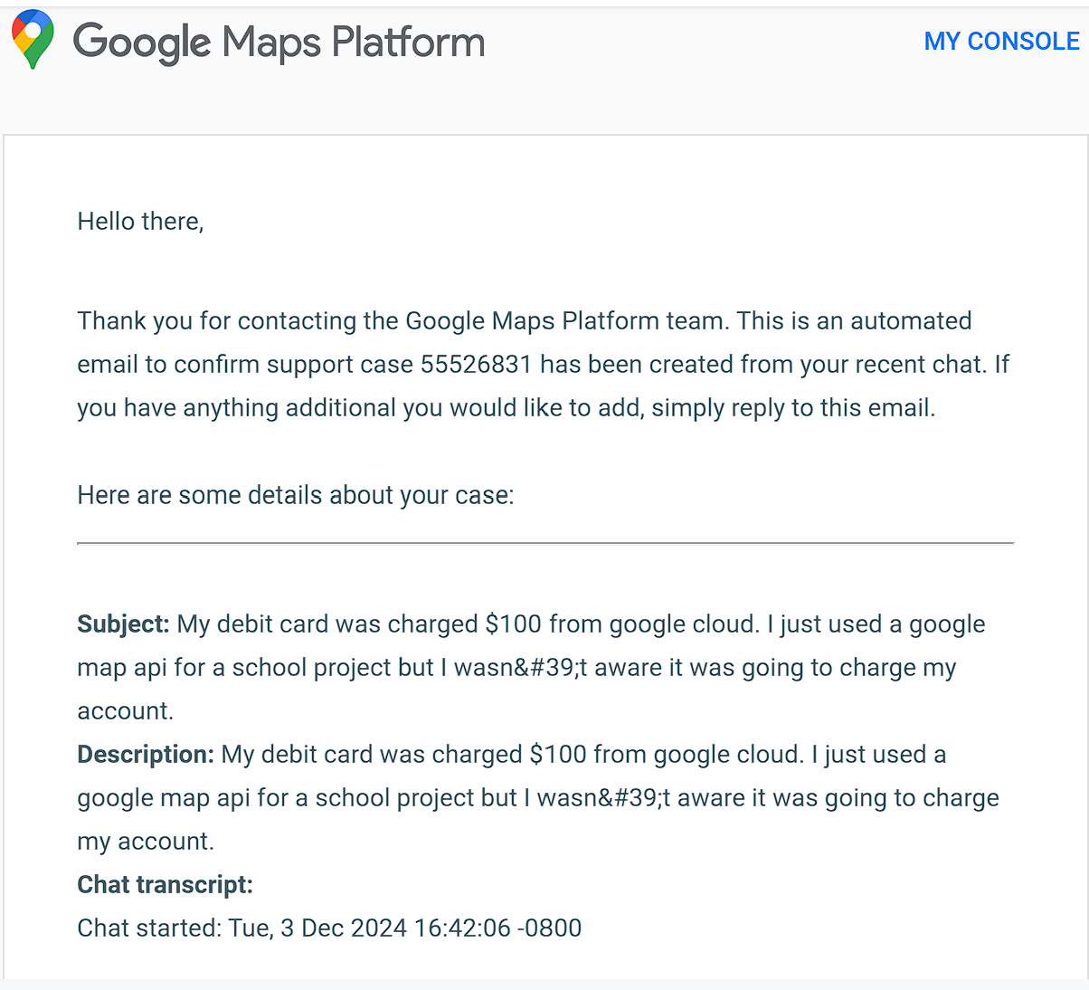
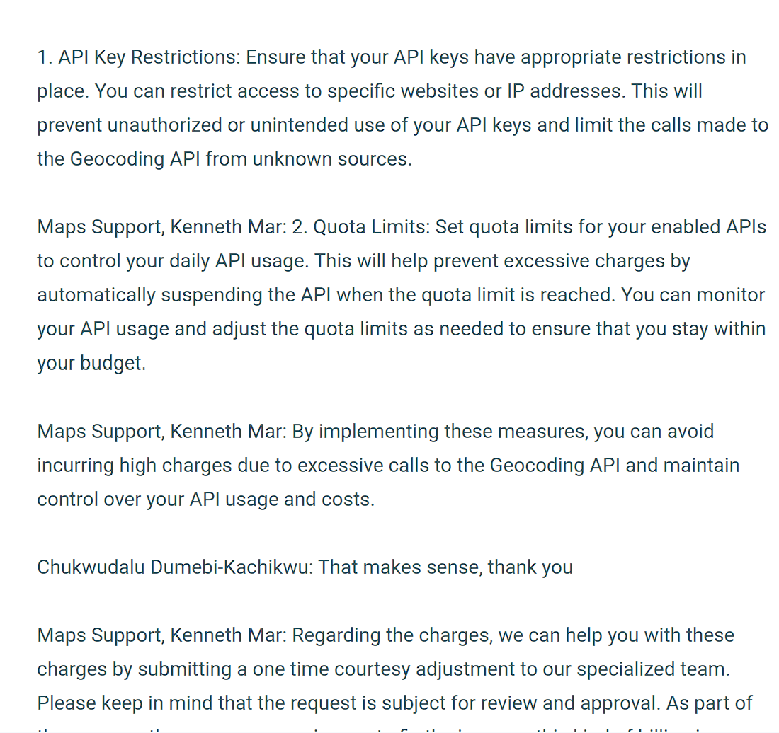

Slide 25
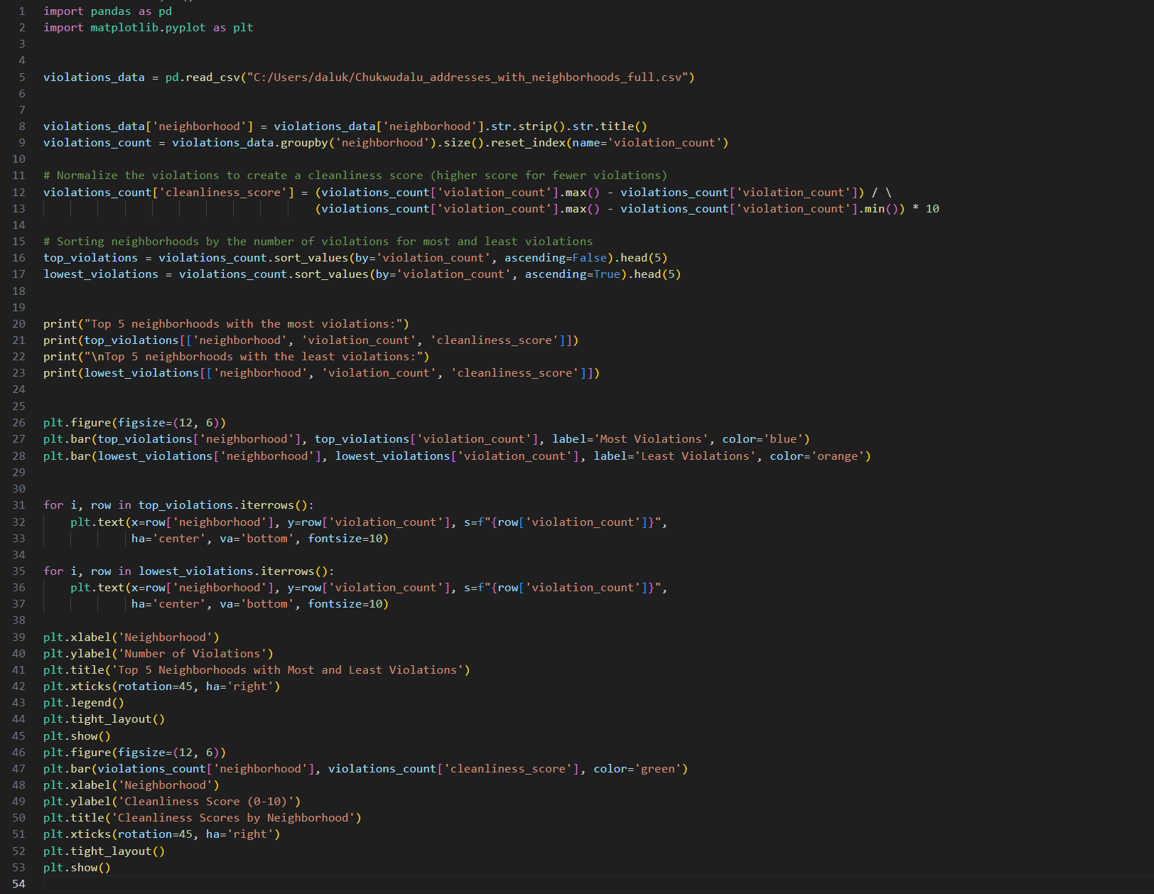

Slide 26
Let's normalize our scores

Slide 27
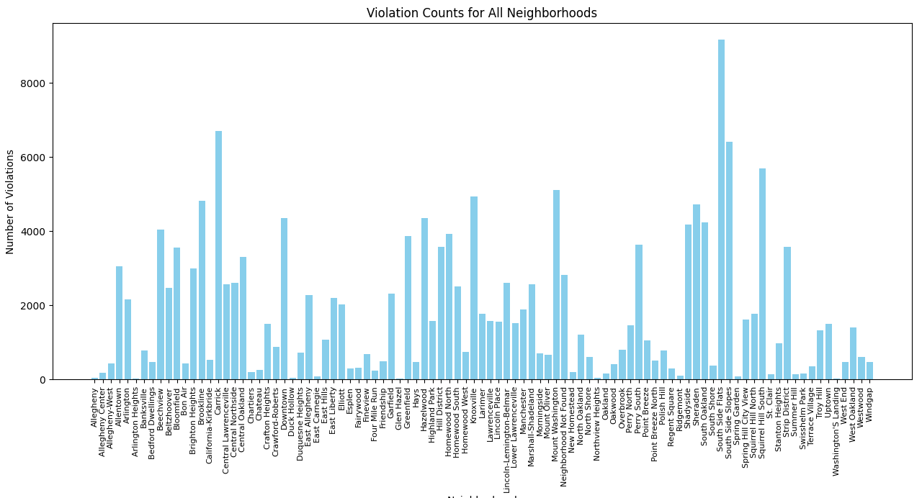

Slide 28
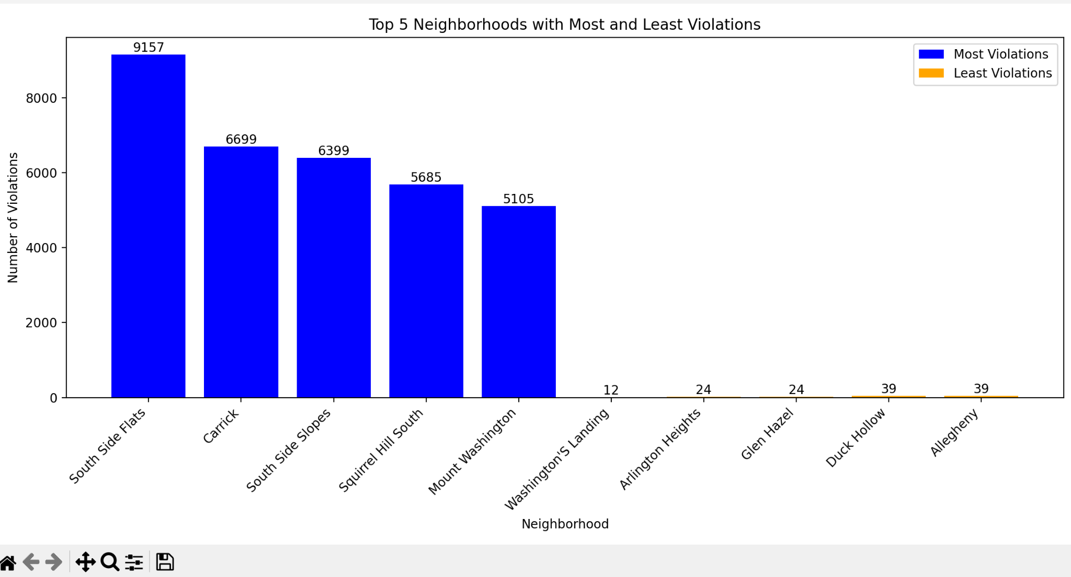

Slide 29
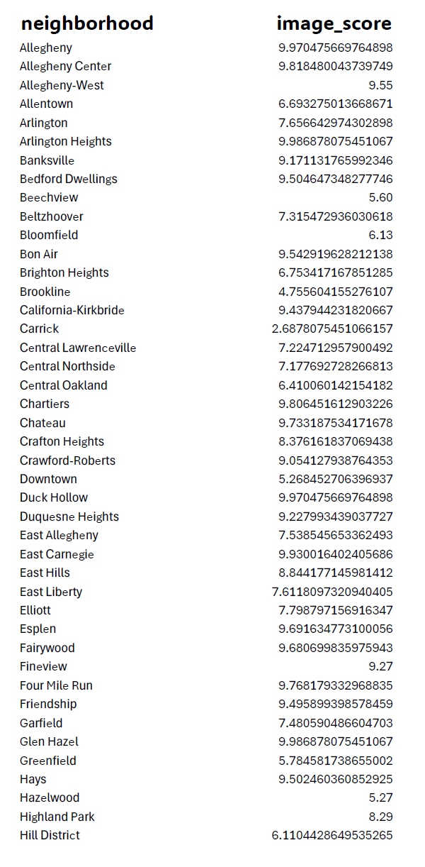
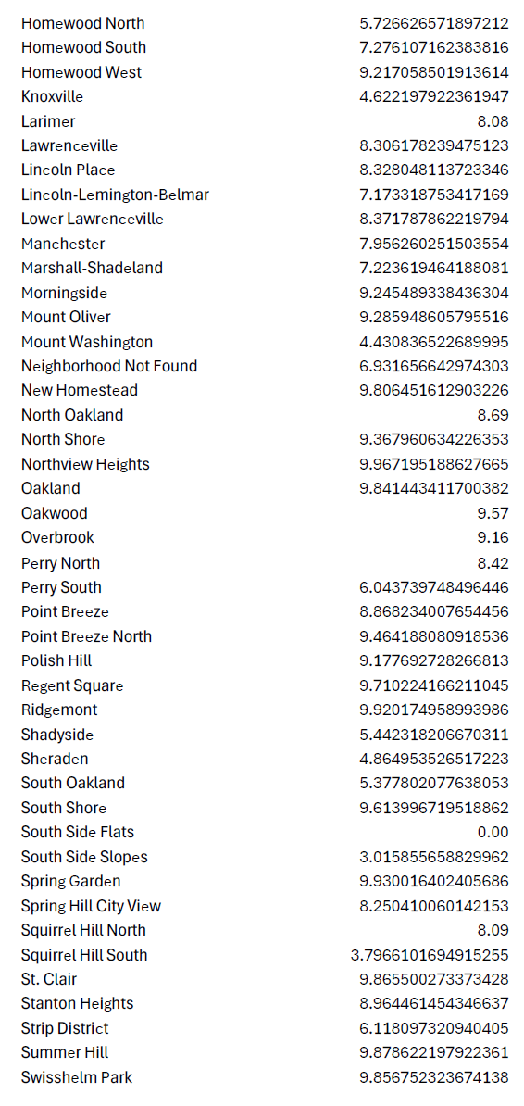
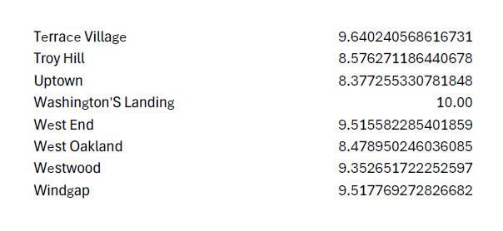
Image Points for Each Neighborhood

Slide 30
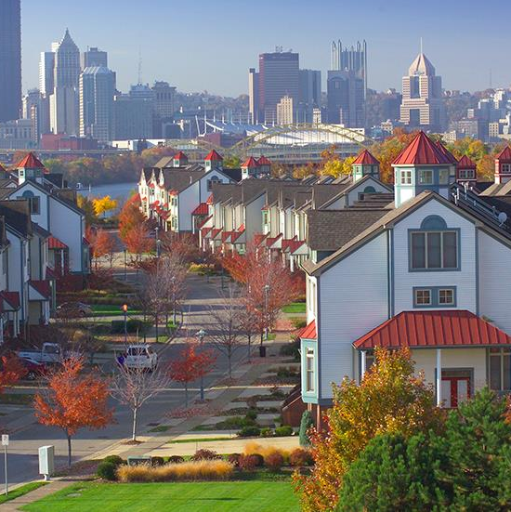
In terms of Image
Washington's Landing
The clear winner is...

Slide 31
Conclusion
So with all that being said and done what neighborhood is the best

Slide 32
16 Points
With a total of

Slide 33
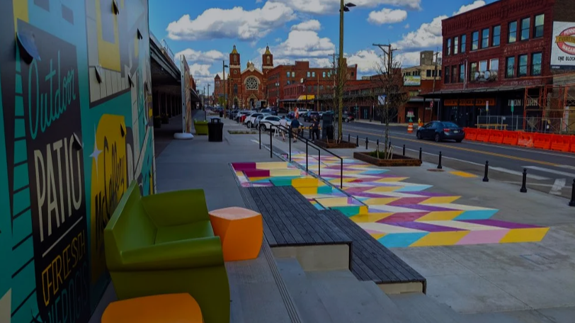
^{Strip District}

Slide 34
Reflection
The neighborhoods that won tended to house wealthier populations
Sania: Since I am the only one in our group from near here (1.5hrs away)I knew a lot about the area. Strip District is definitely one of the more fun/”full” areas in Pittsburgh so I am glad it won
Nicky: I actually don’t have a favorite neighborhood because this is my first time in Pittsburgh and I’m from outside of America. Oakland is the only one I know from now. Through this project, I’ve get to know more neighborhoods and it’s nice.
Dalu: I don’t live in Pittsburgh, so I don’t have a preference for any of the neighborhoods. In the future I would like to scrape the internet to gather more information.

Slide 35
THANKS!
Any questions?

